Slide 1
School Assessment common tasks

Slide 2
How do I…?
Enter a User (Teacher)
Enter a Student
Print Test tickets
Add Student’s accommodations
Process invalidations
Process re-open requests
Request a paper based test

Slide 3
Creating a Teacher user
User’s email
User’s name (first & last)
What type of account you are granting TA or SDE
If you need SA, SRA, or SAC access granted, please contact Nate or Heather in Evaluation Services
SAC – School Assessment Coordinator
TA – Test Administrator
SA - School Administrator
SRA – School Reporting Access
SDE – School Data Entry

Slide 4
Adding Teacher Users

Slide 5
Adding Users

Slide 6
Adding students for testing
You will only ADD students for testing if they enroll from out of district or out of state AFTER Evaluation Services completes the Pre-ID upload
If you have a student that enrolls from another DISTRICT school, please email Heather Rykard to move the student into your school in TIDE – DO NOT create a new record for this student
You will need student’s demographic information (full name, DOB, student number), accommodations and the FLEID (found on Classified tab)

Slide 7
Adding students

Slide 8
Adding students
Enter current
IEP/504 info
Use FOCUS grade
Student
Use Student ID

Slide 9
Printing test tickets
You may reuse printed test tickets for each PM administration or you can reprint for each PM
Once printed, test tickets are SECURE, and must be locked in secure test storage
Test administrators will inventory the tickets that they are issued on test day, and the test coordinator will inventory again once the teacher turns in their materials

Slide 10
Printing test tickets

Slide 11
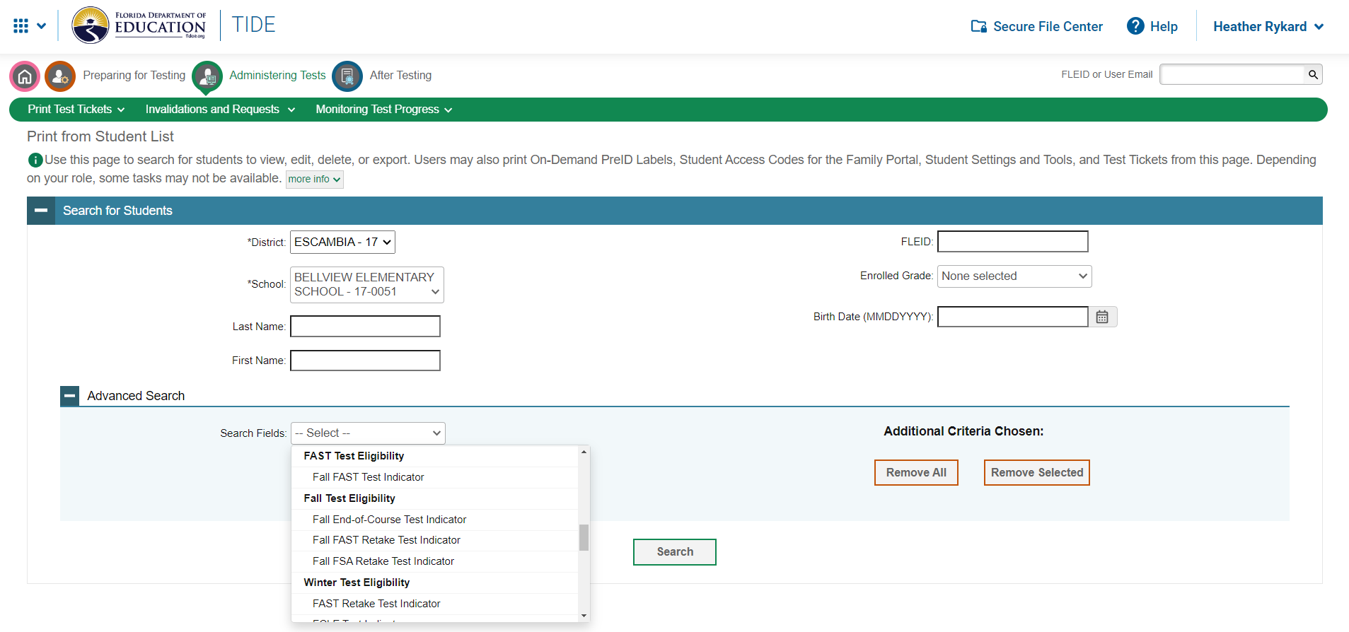
Filter to print
You can filter to print by several different items.
Search by grade
Search by test

Slide 12
Filter options
FAST Test Eligibility
Fall FAST Test Indicator (PM1/PM2)
Fall Test Eligibility
Fall End of Course Test Indicator
Fall FAST Retake Test Indicator
Fall FSA Retake Test Indicator
Winter Test Eligibility
FAST Retake Test Indicator
FCLE Test Indicator
Accommodations
Text to Speech (Read aloud)
Masking
Speech to Text
Text to Speech on Writing Response
Passage Booklet
American Sign Language
Closed Captioning

Slide 13
Filter options

Slide 14
printing

Slide 15
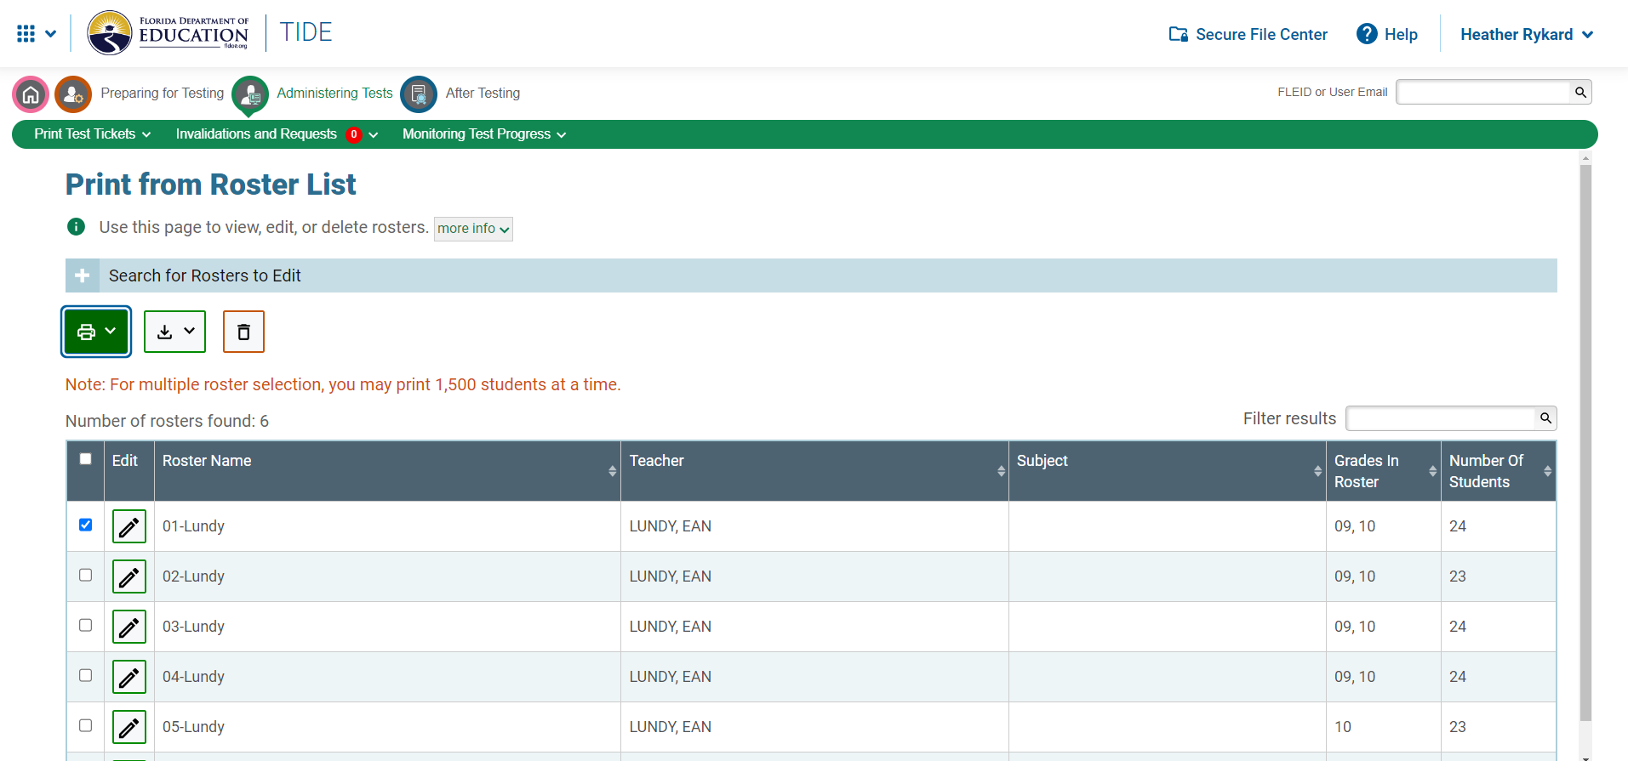
Print from roster
You can print from the uploaded rosters (based on schedule records)
You are able to print the roster or test tickets

Slide 16
add accommodations
You will have to manually add accommodations to the students who qualify for a computer driven accommodation
These are
Text to Speech
Masking
Speech to text
Text to speech on writing response
Passage booklet
ASL
Closed captioning

Slide 17
Add accommodations
Search for a student and then click the pencil icon to edit the demographics
At the bottom of the demographics page, you will turn on any needed accommodations

Slide 18
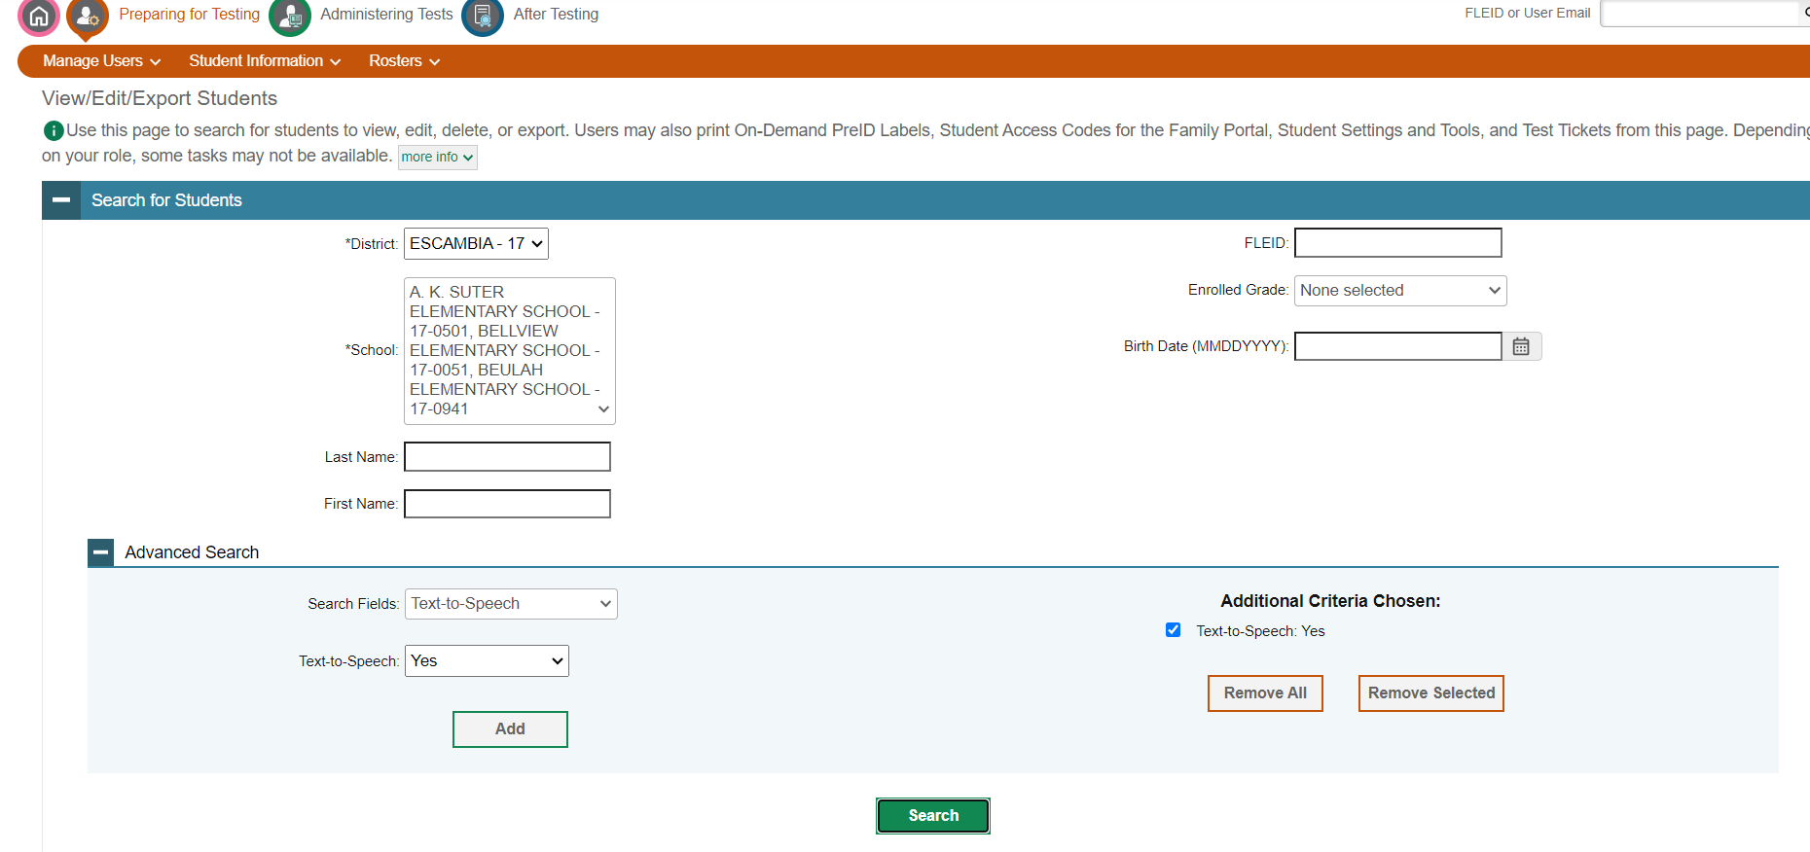
Show accommodations
You are able to print a listing of students that you have enabled accommodations for
Choose “View/Edit/Export students” then under “Advanced Search” look for the accommodation that you want to view

Slide 19
Process invalidations
Invalidations occur when a student’s actions compromise the validity of an assessment.
After consulting the TAM, if you are unsure if the situation IS an invalidation, contact Evaluation Services.
For a computer based test, invalidations are entered into TIDE.
The TAM has a listing of what is considered an invalidation
You will need student’s name, FLEID or Session ID and the reason for the invalidation

Slide 20
Process invalidation

Slide 21
Test invalidation

Slide 22
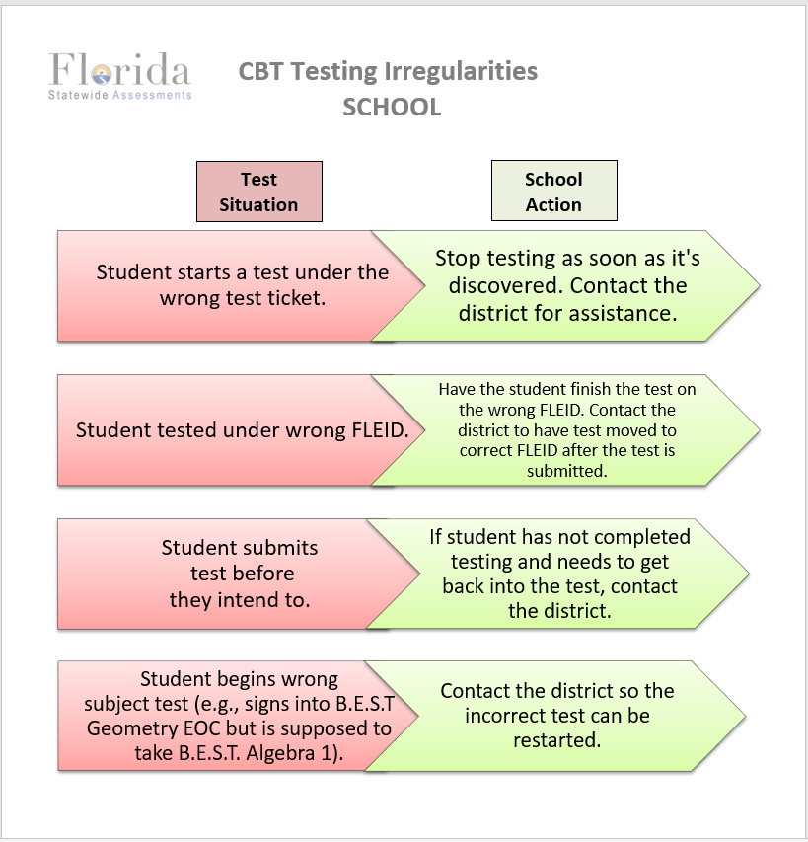

Slide 23
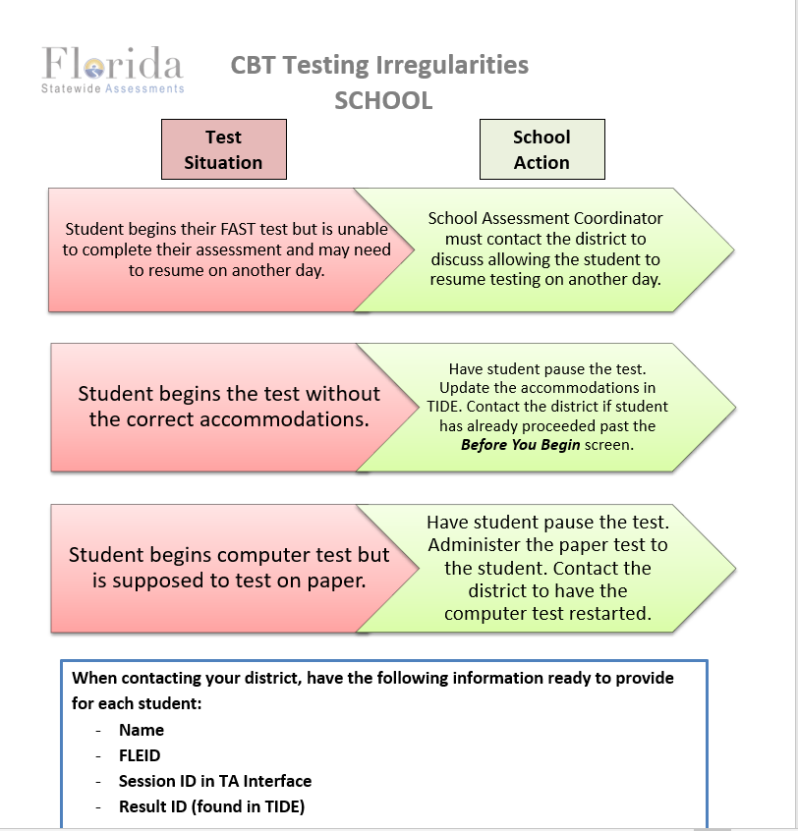

Slide 24
Process a reopen request
If a student leaves campus due to illness, you are able to request a test reopen.
You will need to contact Evaluation Services (Heather or Nate) to let us know that you have made the request.
Re-open – Reopens a test if a student has permission to re-enter. The student’s test must be in Completed, Submitted, or Reported status.

Slide 25
Request paper based tests
If a student’s IEP or 504 plan shows a paper-based test is required – i.e. regular print, large print, braille, one-item-per-page, you will need to request an accommodated test
Complete the google form “PBT Accommodations Request”
You will pick up the test from Evaluation Services once it arrives
Responses MUST be entered into the Data Entry Interface(DEI)*
School Data Entry (SDE) access must be granted in TIDE
Test materials are mailed back as not to be scored**
* Braille tests MAY be entered into DEI or mailed back
** Braille tests not entered into DEI are mailed back as To Be Scored with a Pink label

Slide 26
Paper based request

Slide 27
Questions?
Nate Hazewinkel, Director
850-469-5386
nhazewinkel@ecsdfl.us
Heather Rykard, TSA
850-469-5387
hrykard@ecsdfl.us

